Slide 1

VR-Gaming to Broad
Participation in CS 1.0
Team Members: Santiago Bolivar Product Owner: Francisco Ortega
Instructor: Masoud Sadjadi School of Computing and Information Sciences Florida International University
Final Presentation
Spring 2018
Notes:
7 seconds.( I will select 2 best slides (i will give them extra points and students will present for CIS committee)
Greet your audience, thank them for attending your presentation, introduce yourself, introduce your project, introduce your team members, and quickly indicate what each of you did in a high-level manner, and put more emphasis on your part/contribution.

Slide 2
Project definition
Computer Science (CS) Major is a High demand field
High School graduates do not pursue CS as a Major
Minorities are underrepresented in CS
Create Interest on CS for non-cs Majors
Notes:
10 seconds.
Introduce the problem that the whole project (in all versions) tackles with GIF or screenshot.

Slide 3
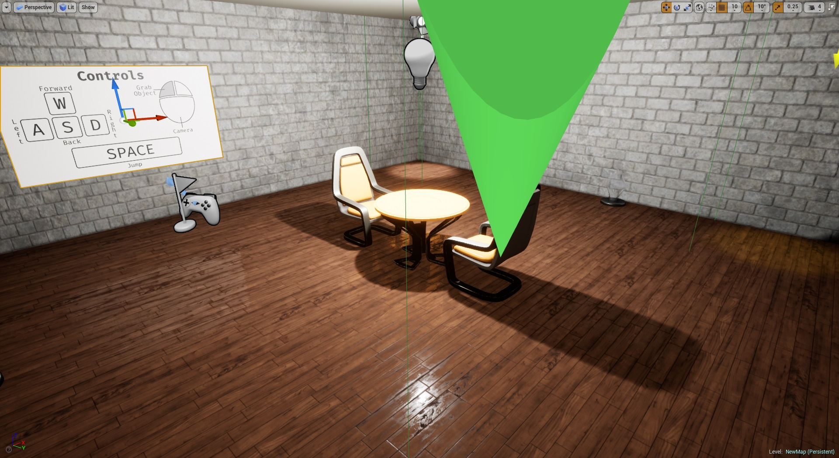
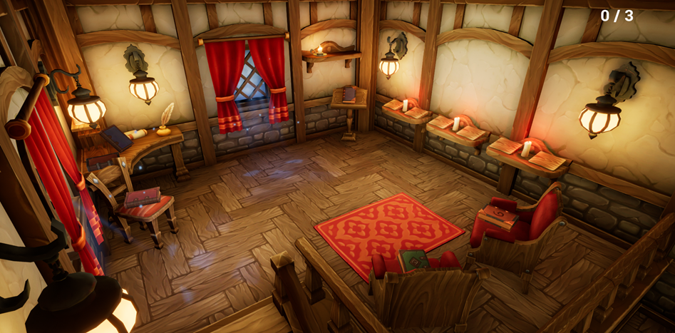
Project definition
Notes:
20 seconds.
Introduce the problem that the your project (in new version) tackles with GIF or screenshot.

Slide 4
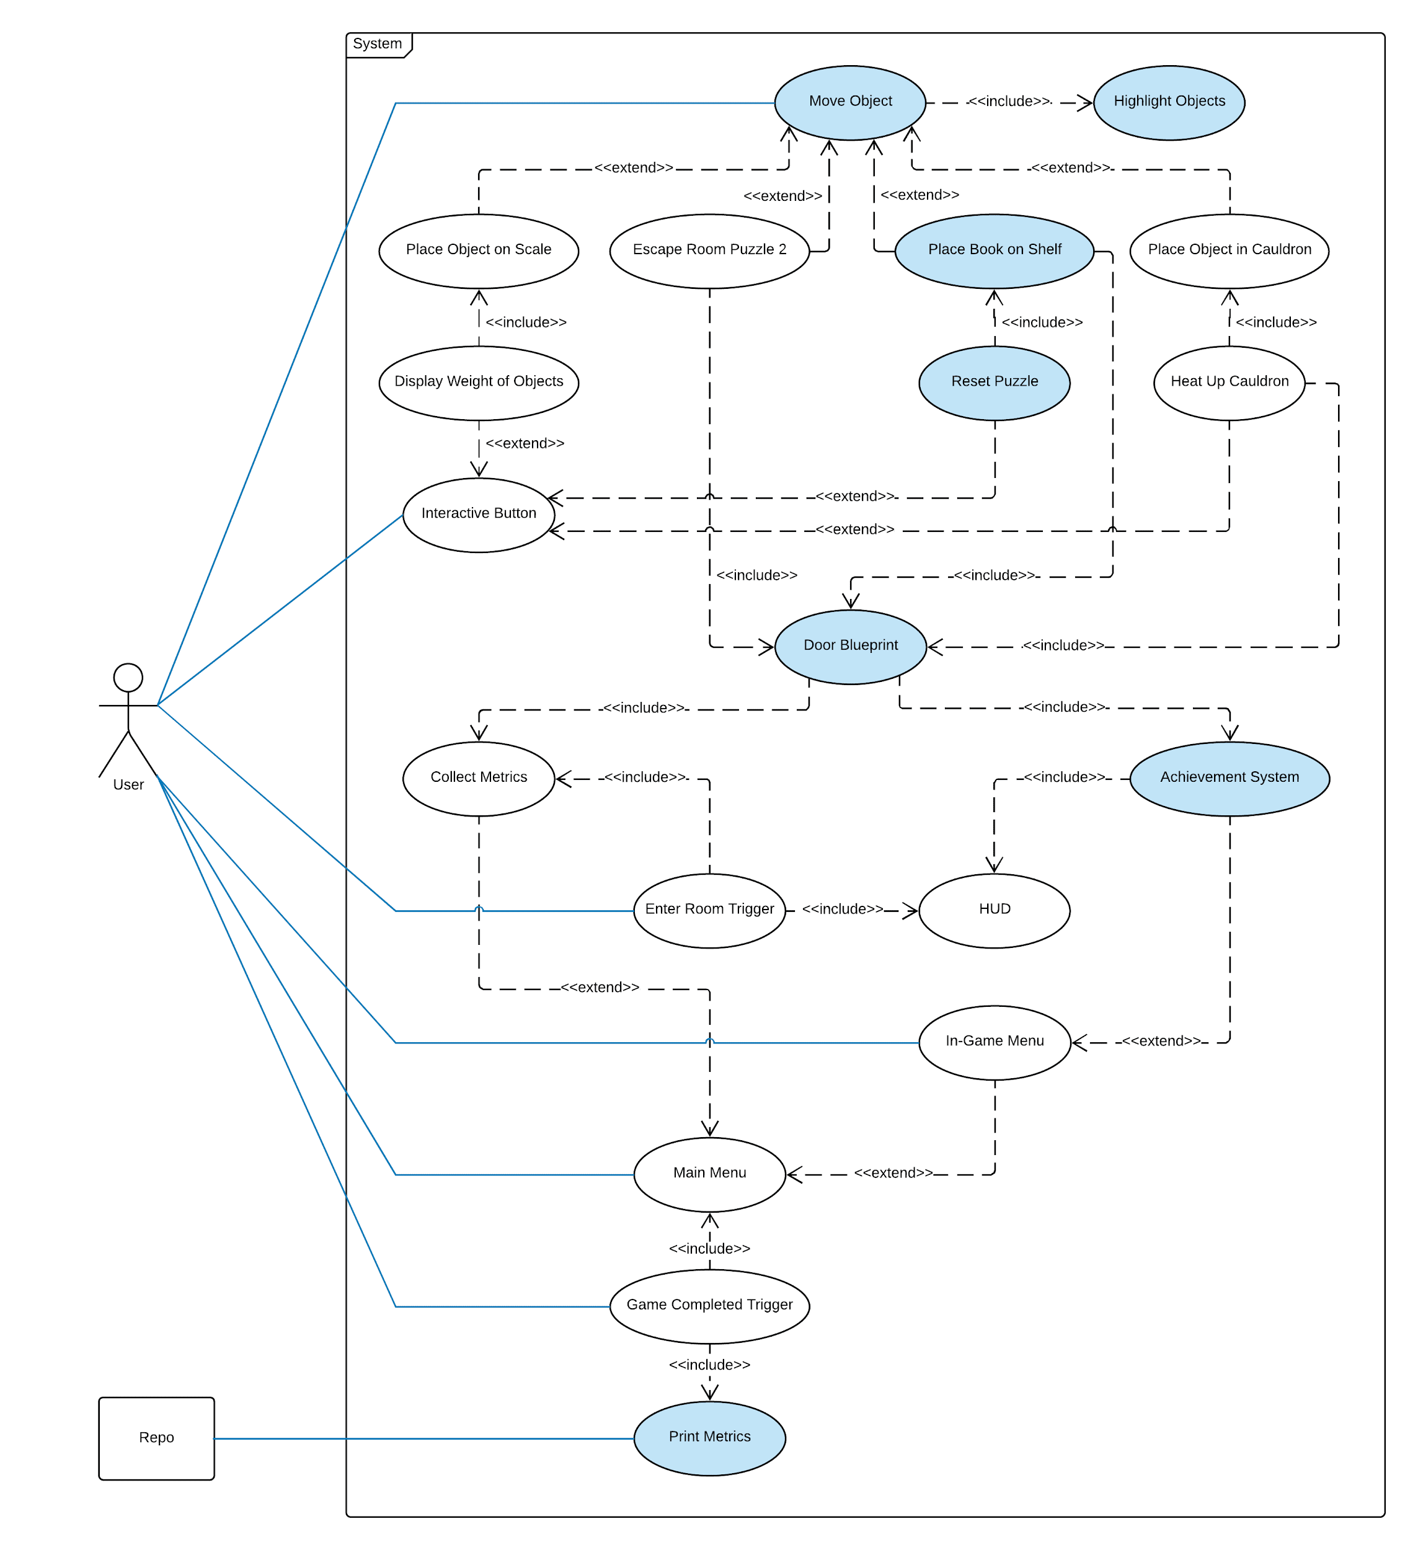
Requirements: Use Cases
Notes:
5 seconds
Show the Use Case Diagram for the whole project. Highlight your use cases.

Slide 5
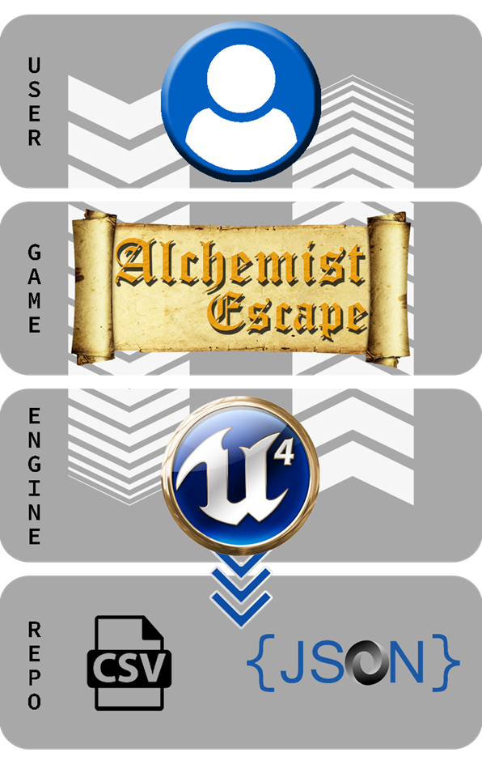
System Design: Architecture
Notes:
20 seconds
System design: Highlight the parts that you contributed to them.
1. System decomposition; identify the architecture patterns used
2. System deployment – h/w and s/w requirements

Slide 6
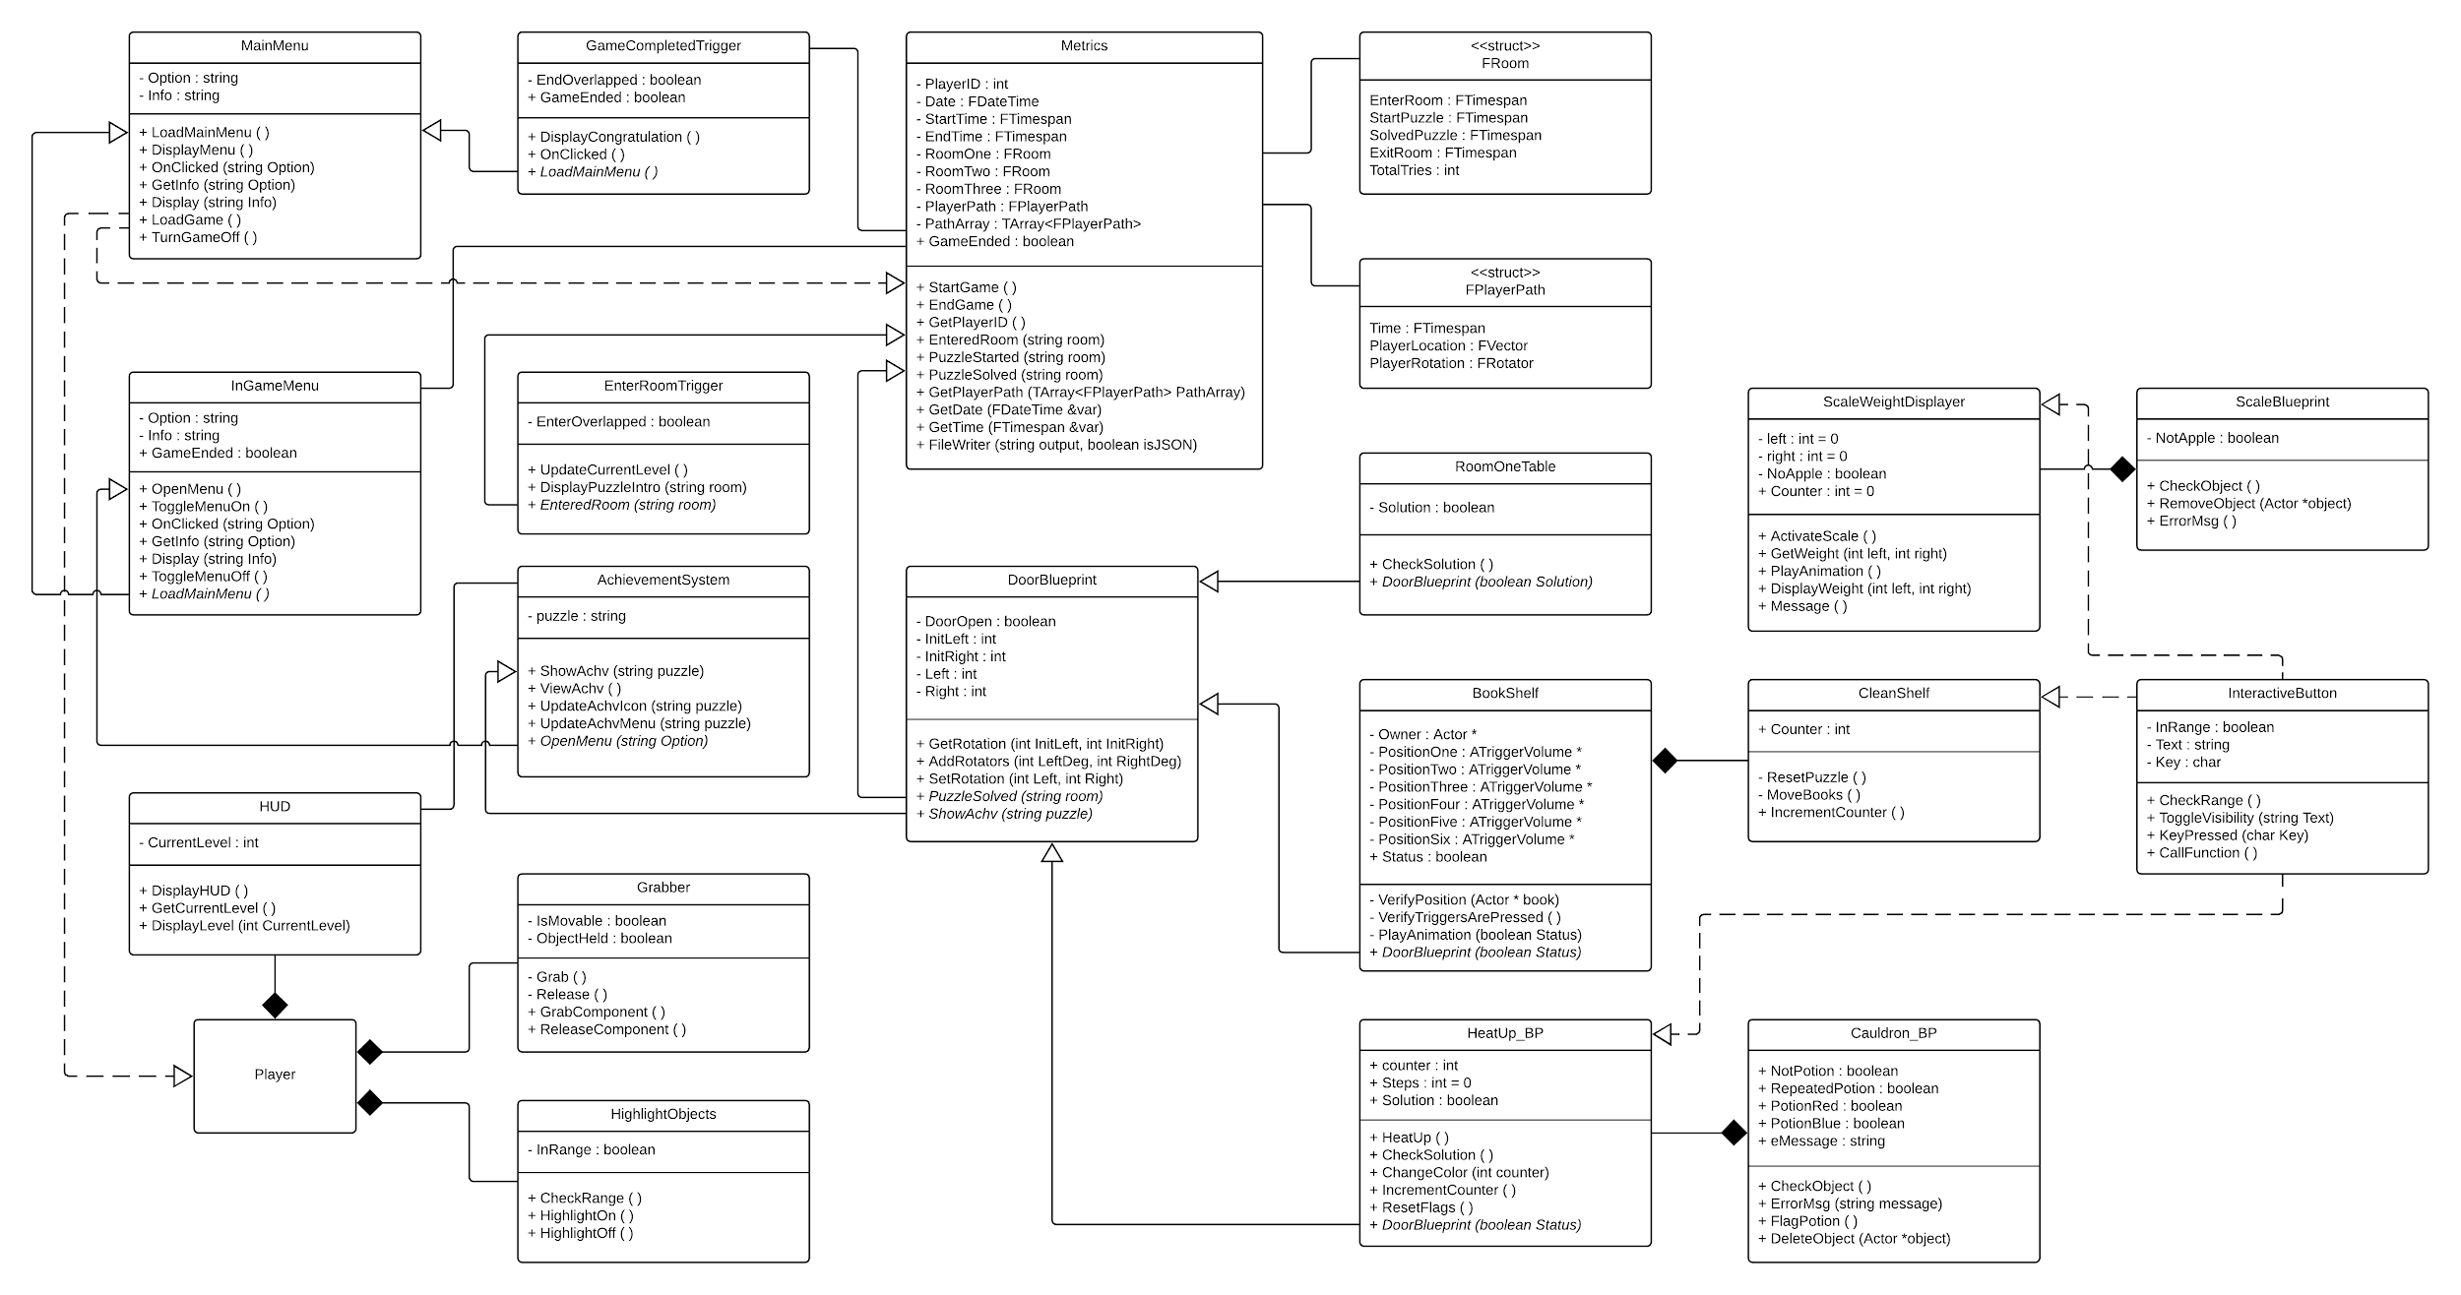
Minimal Class Diagram
Notes:
10 seconds.Minimal class diagram. Highlight the classes that you created/modified
Identify the design patterns used (one or more slides).

Slide 7
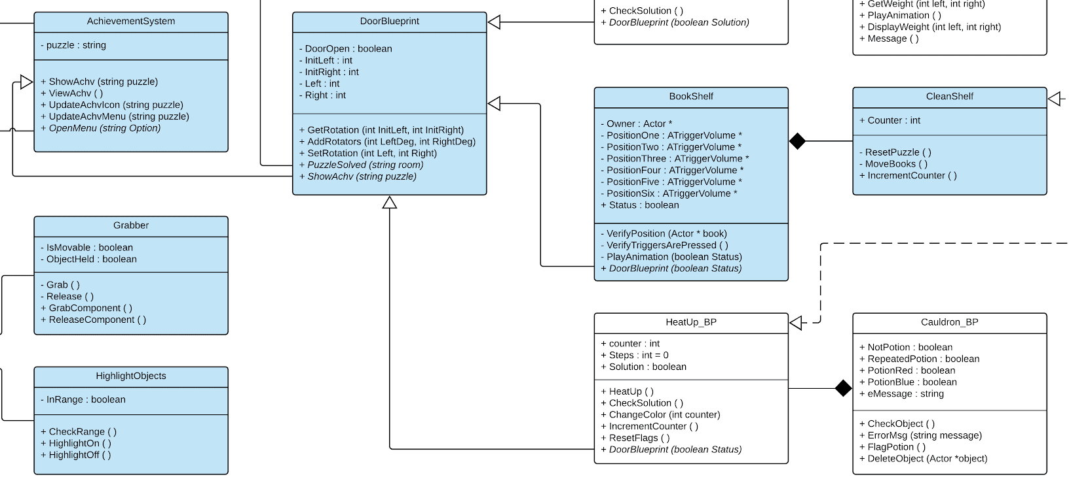
Minimal Class Diagram
Notes:
10 seconds.Minimal class diagram. Highlight the classes that you created/modified
Identify the design patterns used (one or more slides).

Slide 8
User Stories
1. Implement Array Puzzle
2. Implement Correct order notification
3. Implement Achievement System
4. Game Environment Architecture and HCI
5. Implement function to Move Objects
Notes:
5 seconds.
List the user stories that you worked on them.(put in order of importance). Stay focused on the parts that you have been working.

Slide 9
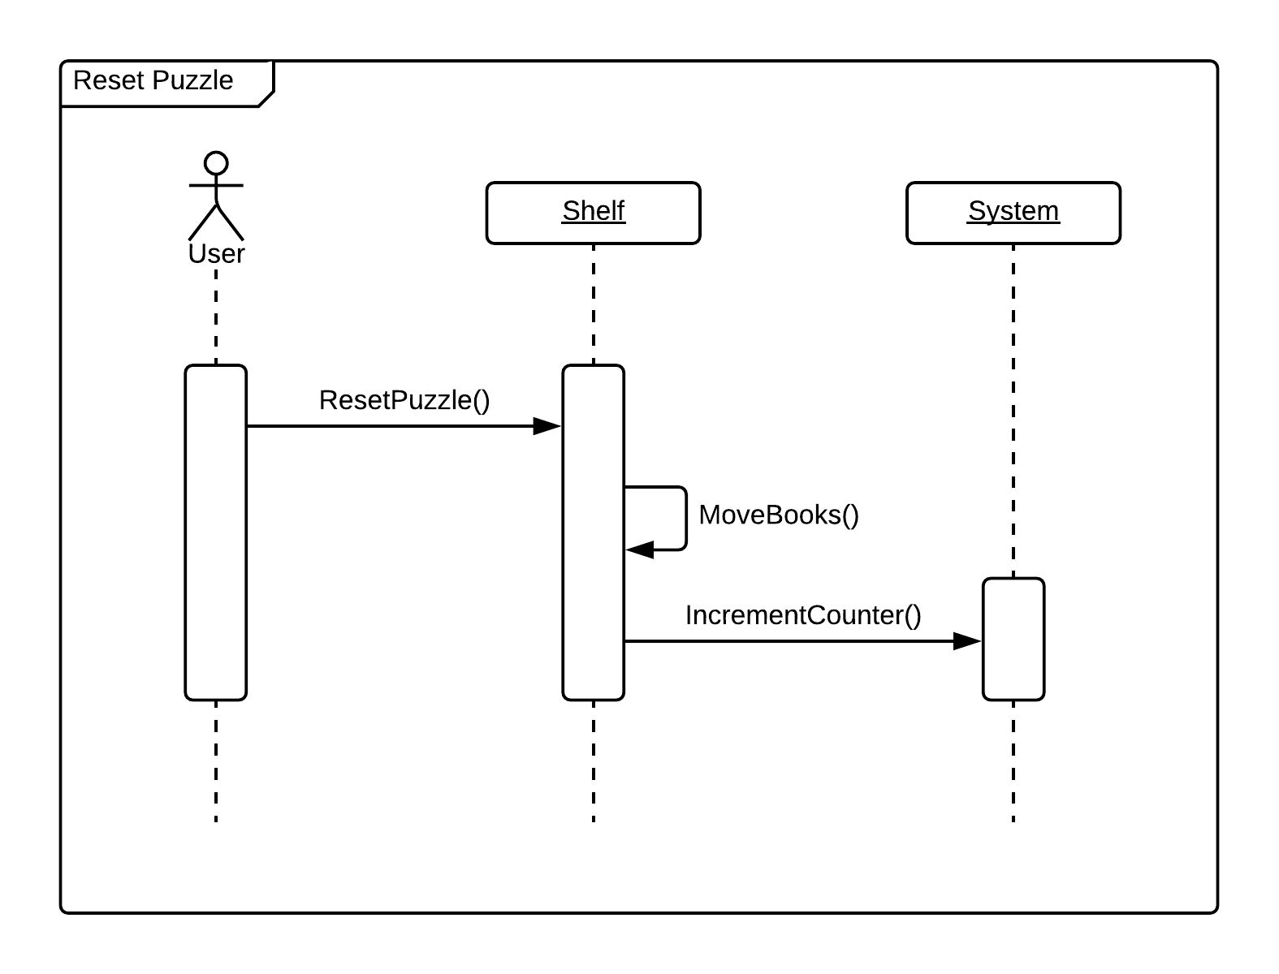
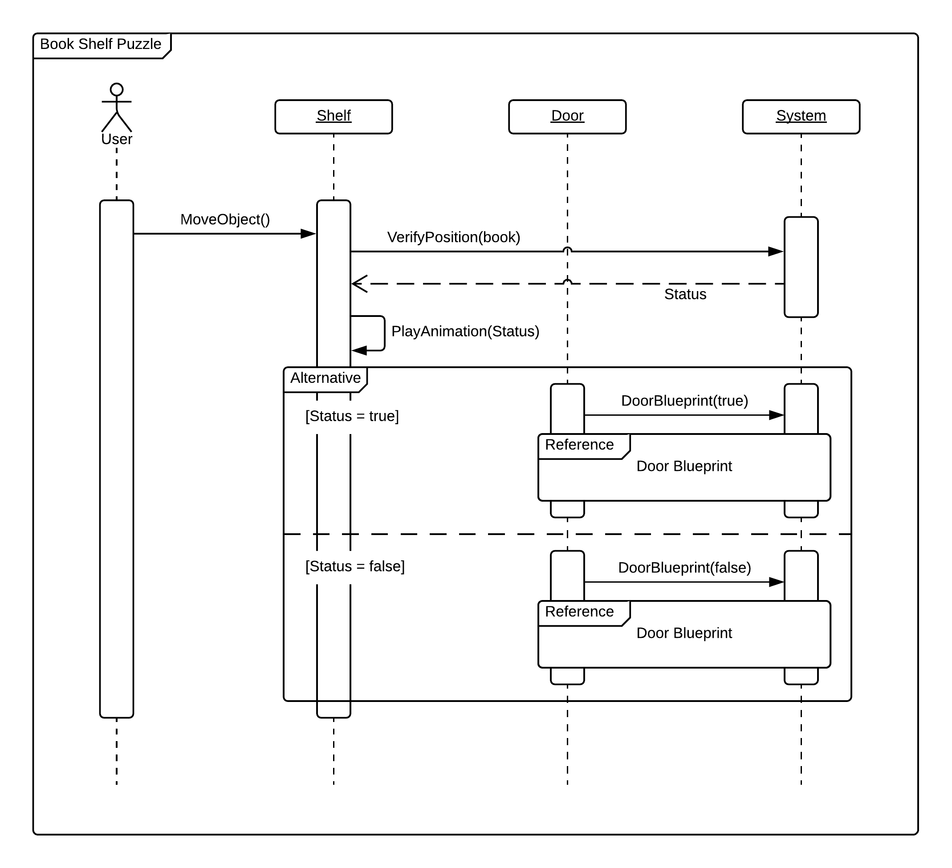
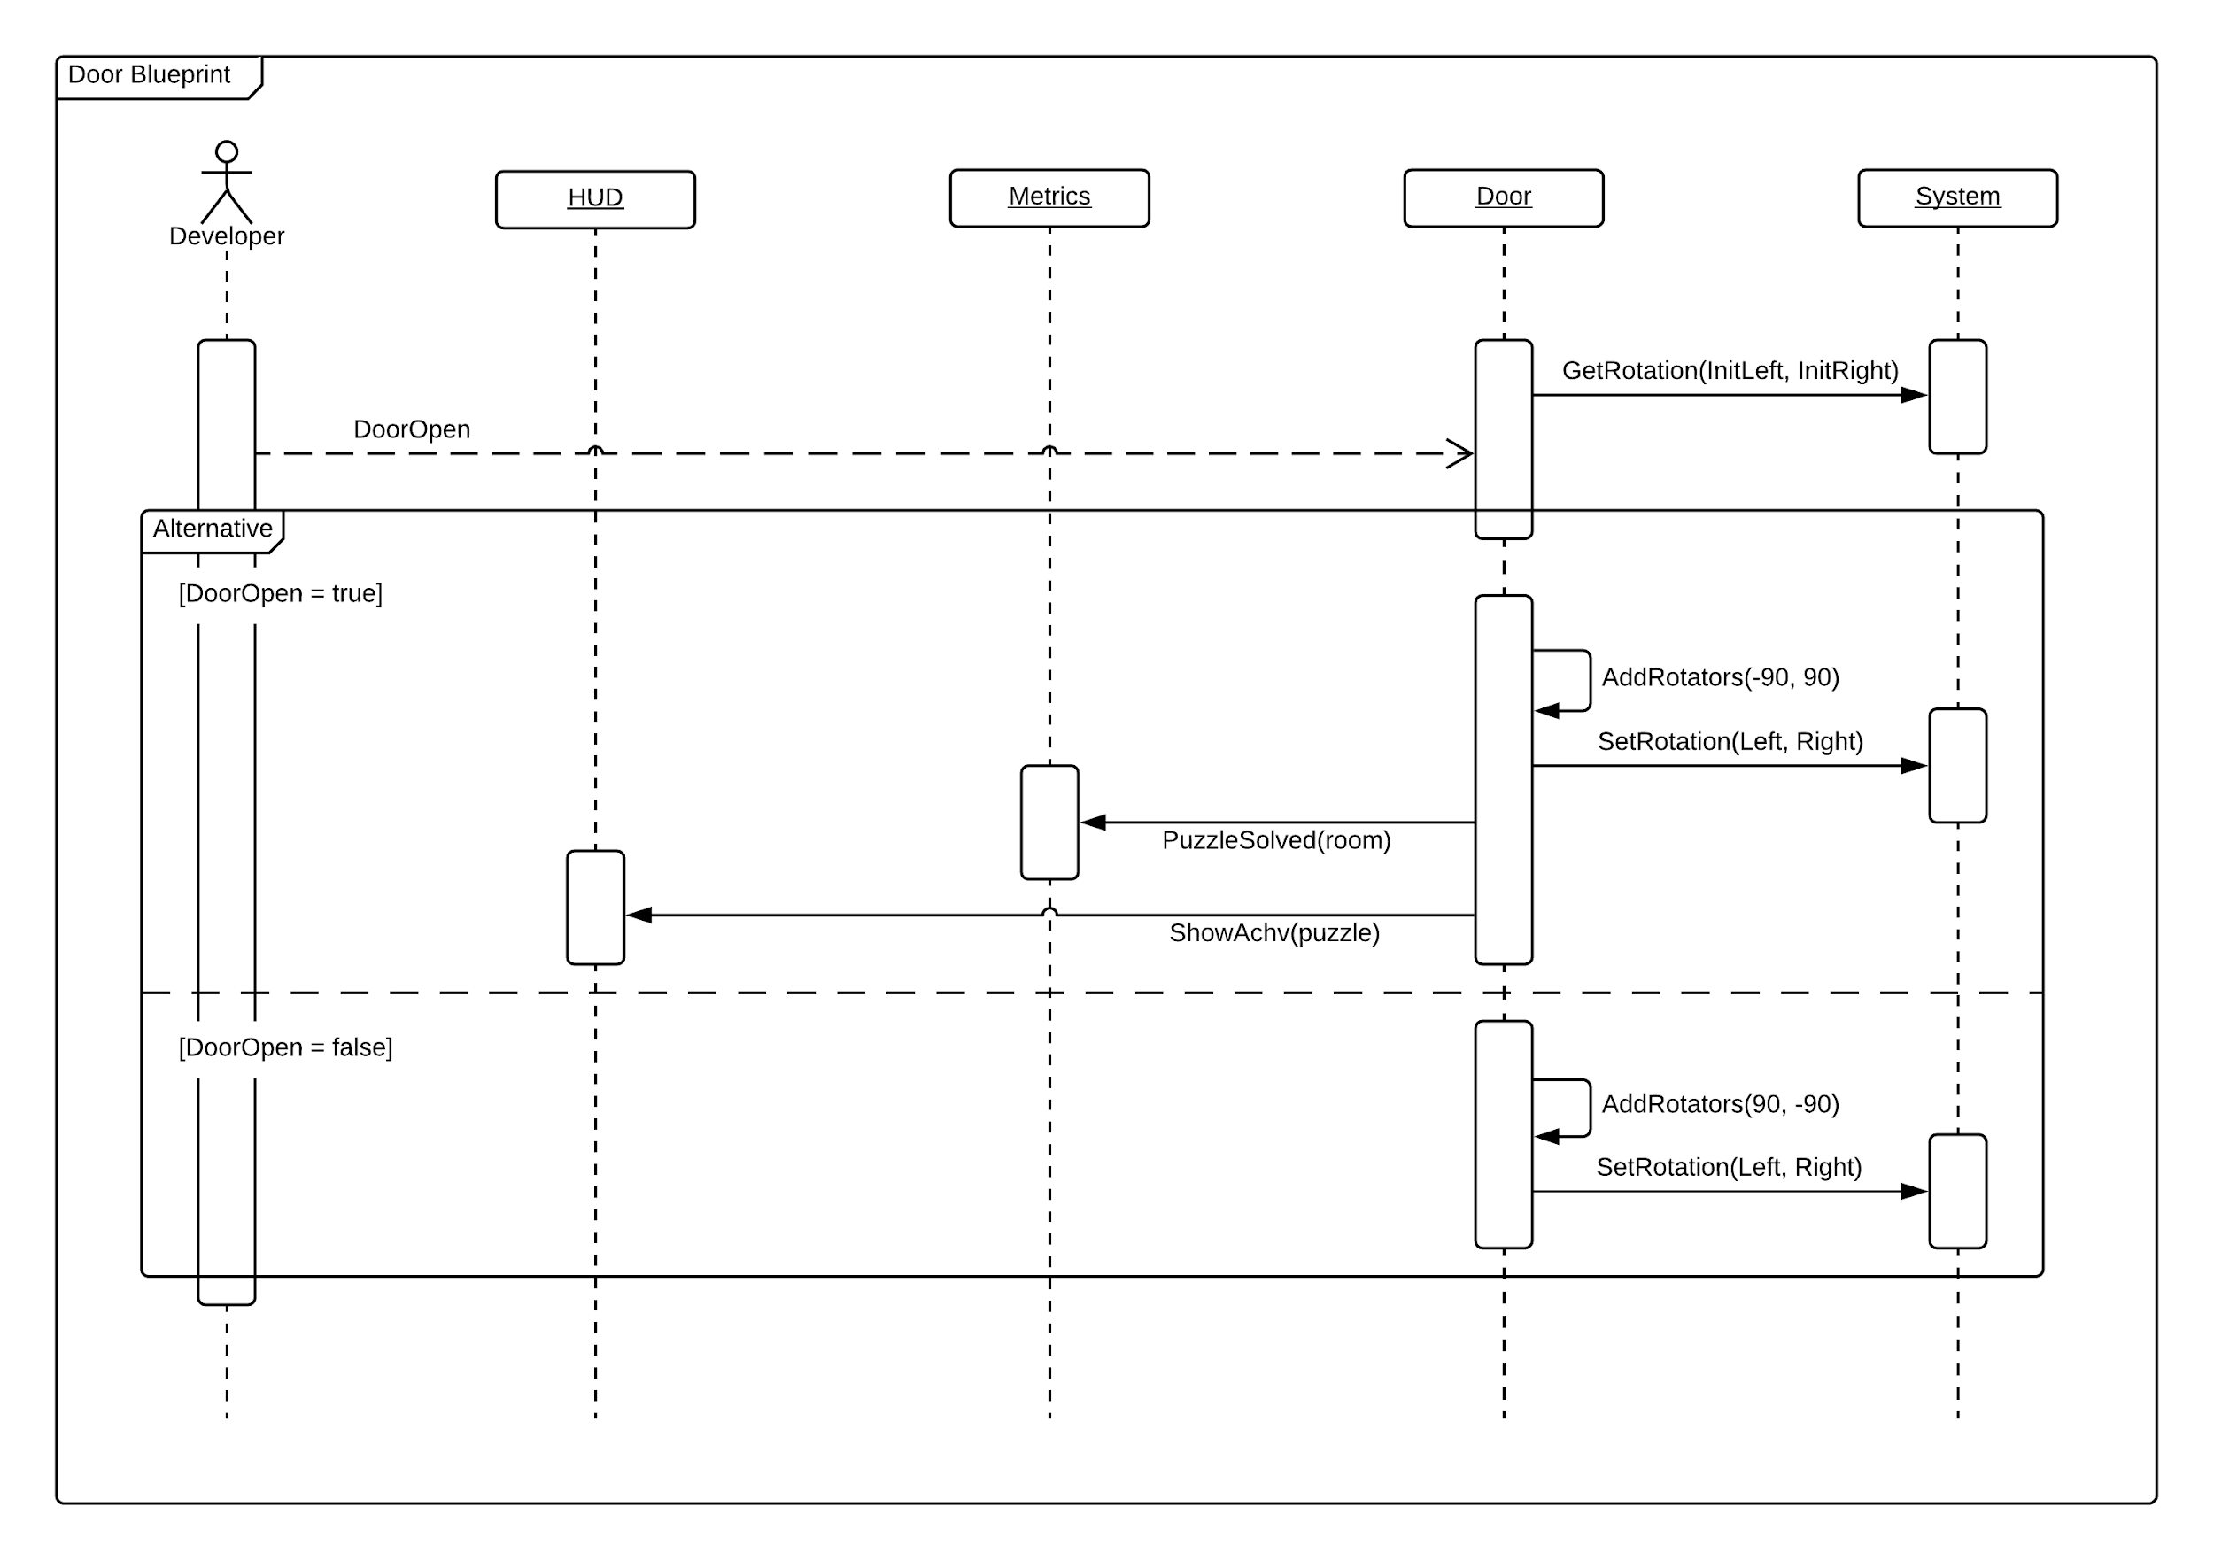
Array Puzzle
Notes:
60 seconds
The tile of user story
The most important user story you worked on it. You have to describe this one very well and be proud of that.
Please present and show the complexity of your work, code, algorithms, and technical challenges and technologies you have used. (you could use screenshot if you want. Visual presentations are better than text presentation)
Go into the details of the most important/significant tasks using bullet lists or visual graphs or state chart diagram
Sequence Diagram for this user story is mandatory (in another separate page if required)
Demo using screenshots or GIF (in another separate page if required)

Slide 10





Puzzle States
Initial State
Possible State
Wrong State
Correct State
Notes:
20 seconds
The tile of user story
Please present and show the complexity of your work, code, algorithms, and technical challenges and technologies you have used. (you could use screenshot if you want. Visual presentations are better than text presentation) - Go into the details of the most important/significant tasks using bullet lists or visual graphs or state chart diagram - Demo using screenshots or GIF (in another separate page if required)
Sequence Diagram for this user story is optional

Slide 11
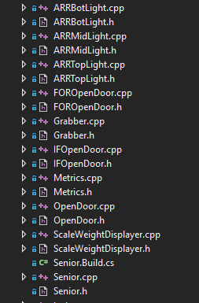
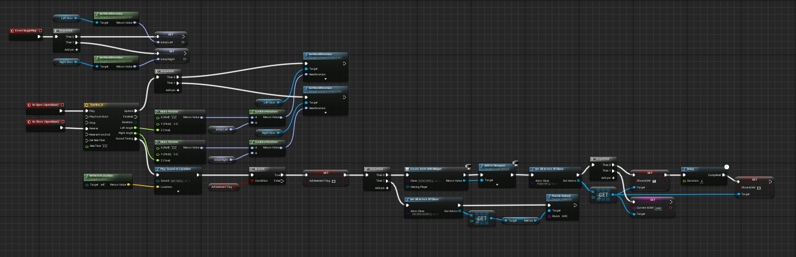
C++
and Blueprints
Notes:
20 seconds
The tile of user story
Please present and show the complexity of your work, code, algorithms, and technical challenges and technologies you have used. (you could use screenshot if you want. Visual presentations are better than text presentation) - Go into the details of the most important/significant tasks using bullet lists or visual graphs or state chart diagram - Demo using screenshots or GIF (in another separate page if required)
Sequence Diagram for this user story is optional

Slide 12
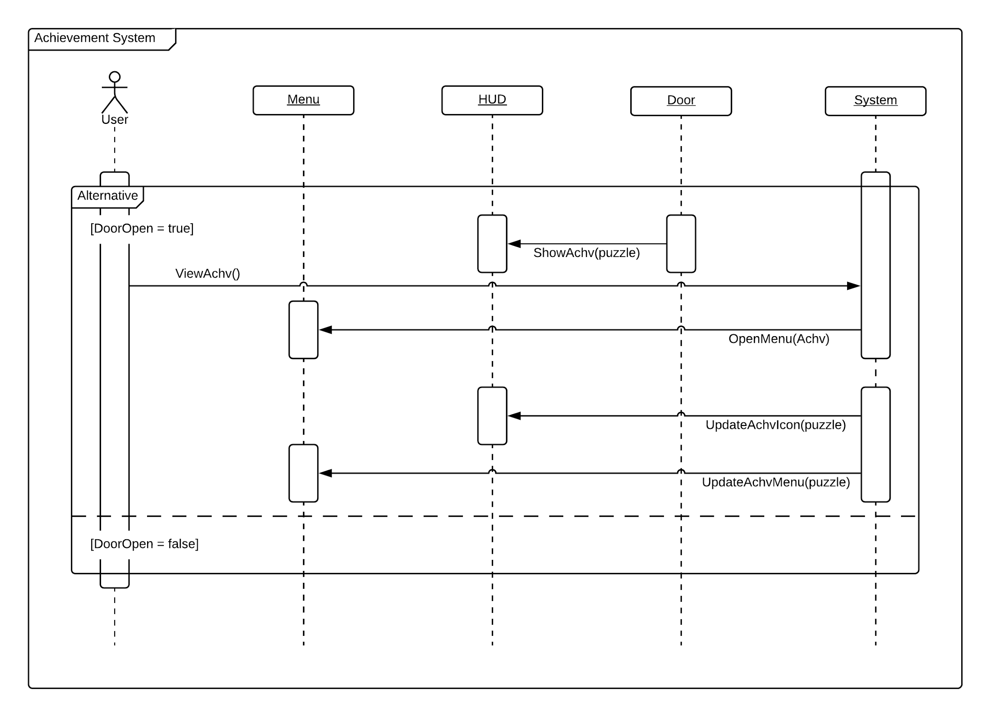
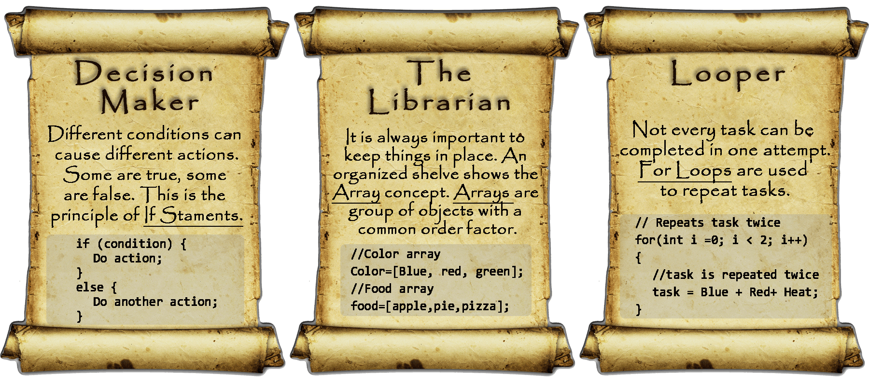
Achievement System
Notes:
20 seconds
The tile of user story
Please present and show the complexity of your work, code, algorithms, and technical challenges and technologies you have used. (you could use screenshot if you want. Visual presentations are better than text presentation) - Go into the details of the most important/significant tasks using bullet lists or visual graphs or state chart diagram - Demo using screenshots or GIF (in another separate page if required)
Sequence Diagram for this user story is optional

Slide 13

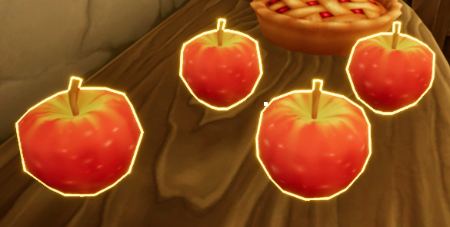

HCI and User Interaction
Notes:
20 seconds
The tile of user story
Please present and show the complexity of your work, code, algorithms, and technical challenges and technologies you have used. (you could use screenshot if you want. Visual presentations are better than text presentation) - Go into the details of the most important/significant tasks using bullet lists or visual graphs or state chart diagram - Demo using screenshots or GIF (in another separate page if required)
Sequence Diagram for this user story is optional

Slide 14





Summary
Santiago Bolivar - sboli001@fiu.edu
Questions?
Thank You!
Notes:
10 seconds
Summarize your contribution, mention your effort for Scrum, Mingle, Github, Google Drive Documentation and minutes
Include your contact information
Ask if anyone has any questions for you.
Thank your audience

